Slide 1
April 10, 2024
Webinar
Personal Property Update
Mike Wikstrom
Personal Property Supervisor
King County Department of Assessments
206-263-2347
mike.wikstrom@kingcounty.gov

Slide 2
Personal Property Update
Personal property intro
About the Personal Property Section
Filing tips
Listing problems
Please interrupt if you have a question
https://dor.wa.gov/taxes-rates/property-tax/personal-property-valuation-guidelines
https://dor.wa.gov/sites/default/files/2022-02/PersProp.pdf

Slide 3
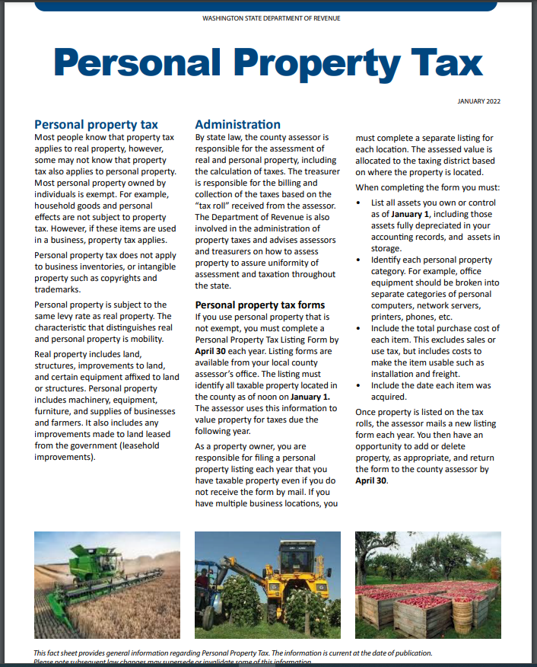

Slide 4
Tangible Personal Property
Machinery & Equipment (M&E)
Furniture & Fixtures (F&F)
Signs
Farm M & E
Leased Equipment
Leasehold Improvements
Communications Equipment
Small Tools, etc.
Software, and subscriptions
Supplies
Equipment used by remote staff

Slide 5
Who is Required to List?
Every individual, corporation, LLC, association, partnership, trust, or estate shall list all personal property in his or its ownership, possession, or control which is subject to taxation...
Total cost, acquisition year, description
Includes freight, installation
Excludes sales tax

Slide 6
Assessment Cycle
2021 – 3rd omit year for AY 2023
2022 – 2nd omit year for AY 2023
2023 – 1st omit year for AY 2023
2024
  Taxes due on assets acquired in 2022 or earlier
  Listings due for assets acquired in 2023 or earlier
  Advance taxes collected for TY 2024 and TY 2025 on sales or closures
2025 – Taxes due on assets acquired in 2023 or earlier
2025 – Taxes due on 2024 omits

Slide 7
Other Requirements
April 30 filing deadline
Up to 25% non-filing penalty, plus 20% per year
Subject to auditing and omitted assessments
“In all cases of failure to obtain a statement of personal property, from any cause, it shall be the duty of the assessor to determine the amount of and assess the value of all property” RCW 84.40.200

Slide 8
Exemptions
Household effects
Inventory
Tribal or foreign-government owned
Head of family (report in listing)
Non-profit (apply to DOR)
Farm equipment (apply to Assessor)
Alcohol fuel or biodiesel manufacture (report to Assessor)

Slide 9
About us
14 auditors and support staff
Functions
  Account maintenance
    29,000 business accounts
    22,000 listings
    Sales, name changes, new and closed businesses
  Compliance
    Discovery
    Auditing

Slide 10
About us
Assessment stats 2022:
  Total taxpayers 17,000
  Total value $17.3 billion
  Top 20 taxpayers $5.7 billion
  Boeing $1.5B
  Microsoft $1.2B
  Amazon $792M
  Top 100, over $9.2 billion
  Median $92K
  Bottom half $344 million (about 2%)

Slide 11
Common Listing Problems
  Filing in more than one format
    eListing and paper
  Assessment notices are ignored
  Over- or Under-reporting LHI
    Owner-occupied
    Real property
  Listing assets of apartments or condos
  Business sold, closed, moved out of KC

Slide 12
Problems (cont)
  Improper asset categories
  Duplicate accounts
  Not removing scrapped assets
  Items in storage
  Customization and development of software
  Software subscription and license fees
    Report total annual cost
    Subscriptions assessed 100% of annual cost
    Licenses 100% first year, 50% second, then 0

Slide 13
Problems (cont)
  Over-reporting supplies, or none reported
  Reporting home-based businesses
  Listing leased equipment
  Assets that were transferred out of the county
  Sales tax: no for PP, yes for LHI
  No account number

Slide 14
Resources
Email Address | personal.property@kingcounty.gov
Phone | 206-296-5126 or 800-325-6165 x65126
Hours of Operation | Monday through Friday 8:30 to 4:30 Pacific
Website | http://www.kingcounty.gov/assessor/
Leasehold (Tenant) Improvements, Property Tax Bulletin, Department of Revenue | https://dor.wa.gov/sites/default/files/legacy/Docs/Pubs/Prop_Tax/NewsletterQ12014.pdf
Mailing Address | King County Department of Assessments Personal Property Section King Street Center 201 South Jackson Street, Room 708 Seattle, WA 98104
RCW | Chapter 84.40 https://app.leg.wa.gov/RCW/default.aspx?cite=84
WAC | Chapter 458-12-060

